Slide 1
Communication Aptitude Test (CAT)
CAT Automation Proposal
April 2026

Slide 2
Communication Aptitude Test (CAT)
Communication Aptitude Test (CAT) started in 2016 supporting one line of business and grew to support 28 LOBs in 2020. A hiring benchmark of 2.2 (CEFR B1) followed by the Talent Acquisition Team in PH and IND.
The CAT Written Assessment was introduced in 2019 and the CAT Chat assessment was added in 2024 to support Non-voice LOBs. In 2024, the CAT Center was established in India to support voice and non-voice hiring.
Question Category
Task
Describe and Instruct
Compare and Contrast
Decide and Justify
CEFR | CAT 3.0
<A1 | < 1.4
A1 | 1.6 – 1.8
A2 | 2.0
B1 | 2.2
B2 | 2.4 – 2.8
C1 | 3.0 – 3.4
C2 | 3.4 >
Description and narration of events or topics
Comparison or Differentiation
Expound on a choice.
Presentation and inference.
Discourse Type
Expected Responses
Description
Narration
Interactive discussion
Short and extended monologue and interaction
Clear and concise
Sequential
Logical

Slide 3
CAT Assessment Structure
Rating Scale | Uses parameters based on language competencies/categories which are arranged on scales corresponding to ability and level.
Voice CAT Segments | 2 PART ASSESSMENT includes a free flow conversation and call simulation Conversation – Participant will be asked to share something about their self. The succeeding questions will be based on what they will share. Job Audition – uses a standardized handout that is user-friendly with highly customizable scenarios that is relevant for all business. Assessments are conducted via Samespace (routing manager)
Non-voice CAT Segments | Job Audition – uses a standardized handout that is user-friendly with highly customizable scenarios that is relevant for all business Email assessments are done via Testmoz (online tool) Chat assessments are done via MS Teams
Form Type | Universal CAT uses a standardized form supporting all businesses. This form is housed in the CAT Ecosystem in Lighthouse and will only have a single form designed for all accounts. A standardized handout is used with highly customized scenarios applicable to any LOB.

Slide 4
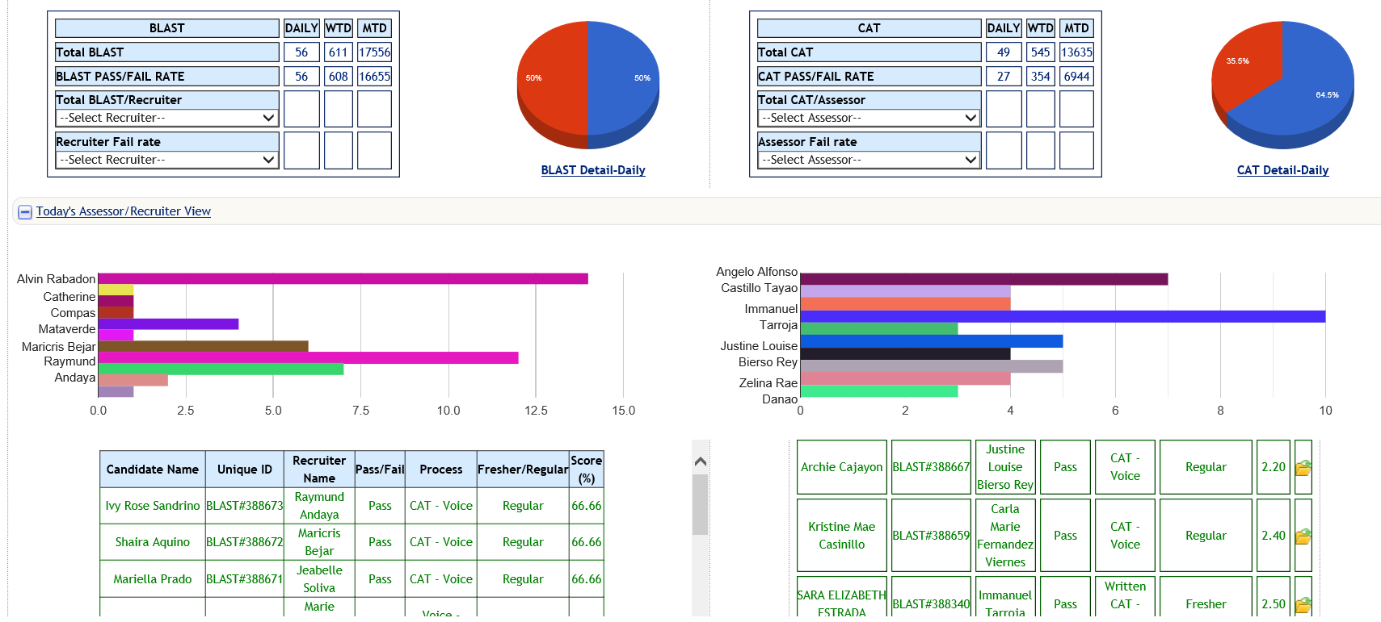

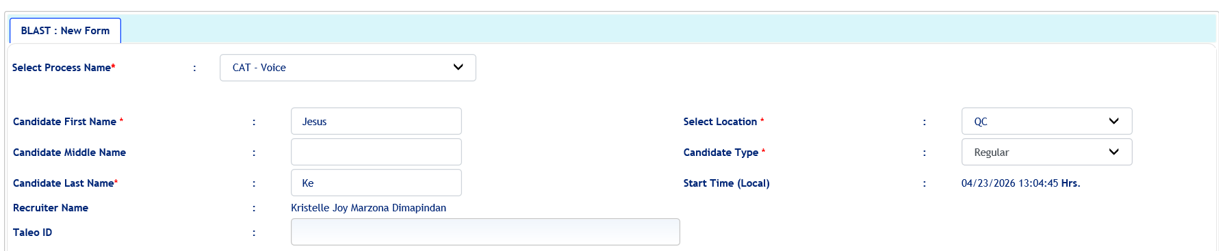
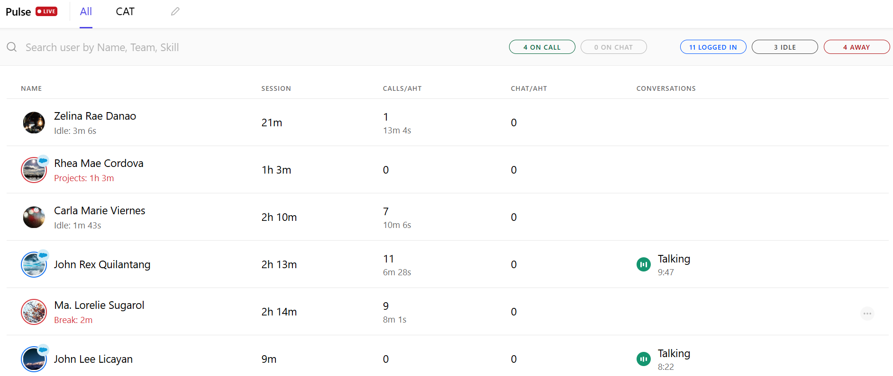

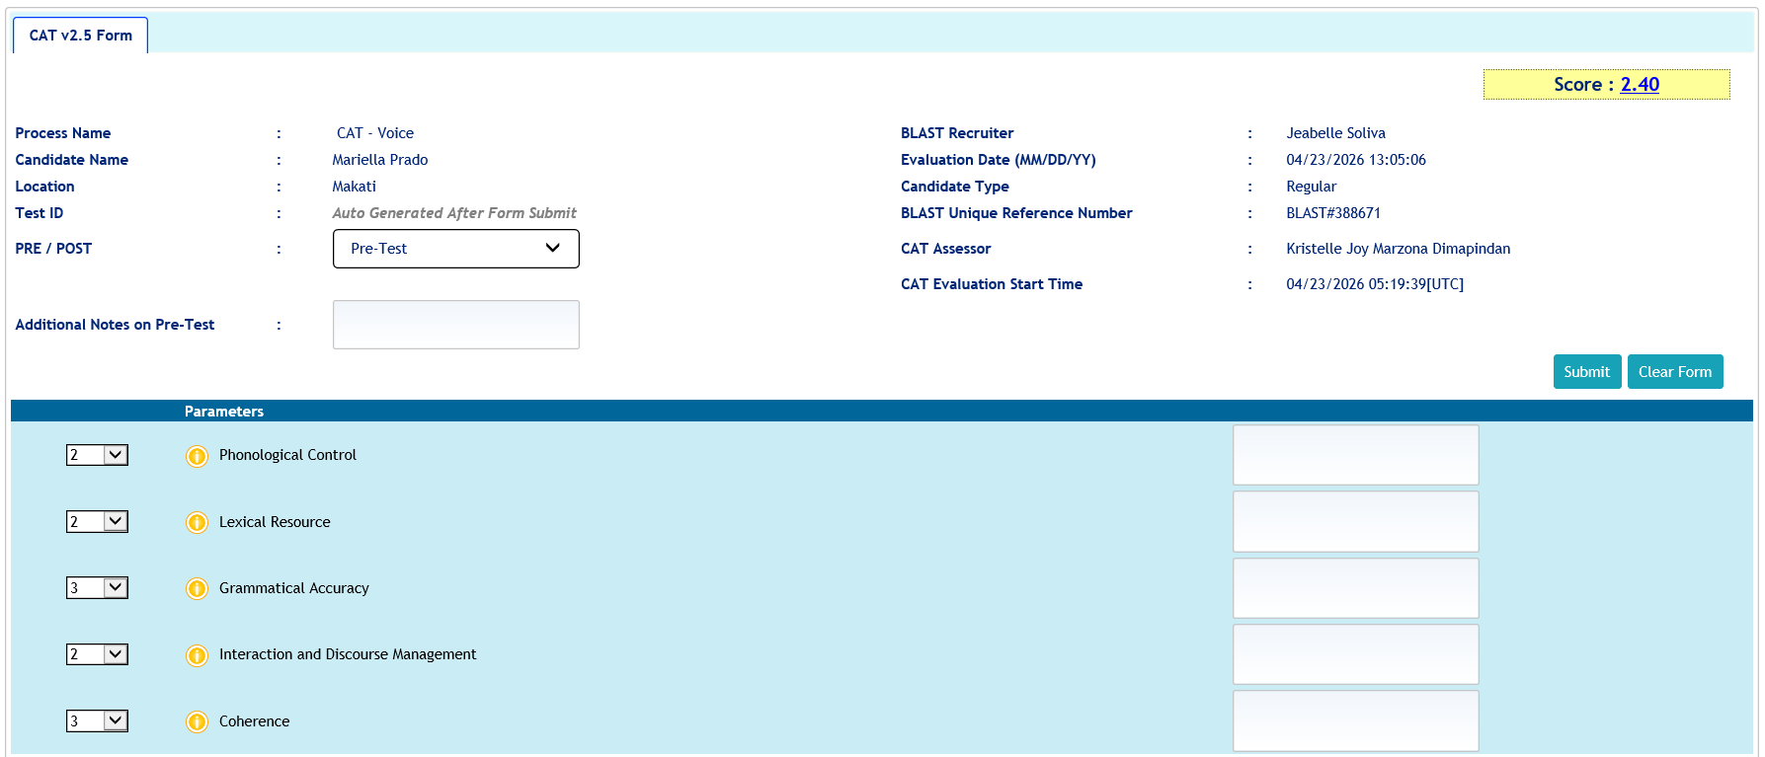
Voice CAT Endorsement Process
Recruiter creates candidate profile to generate BLAST ID via Lighthouse
Candidates with valid BLAST IDs will be endorsed to the CAT Center via Samespace
Results are published real time
Assessment form is accessed via Lighthouse

Slide 5
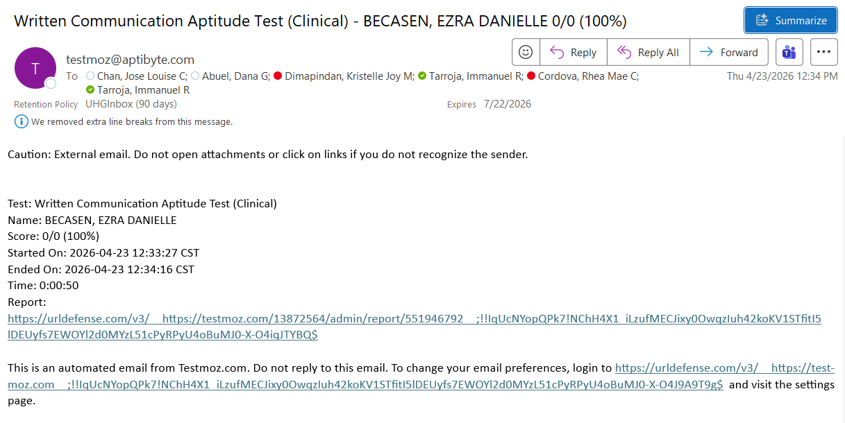
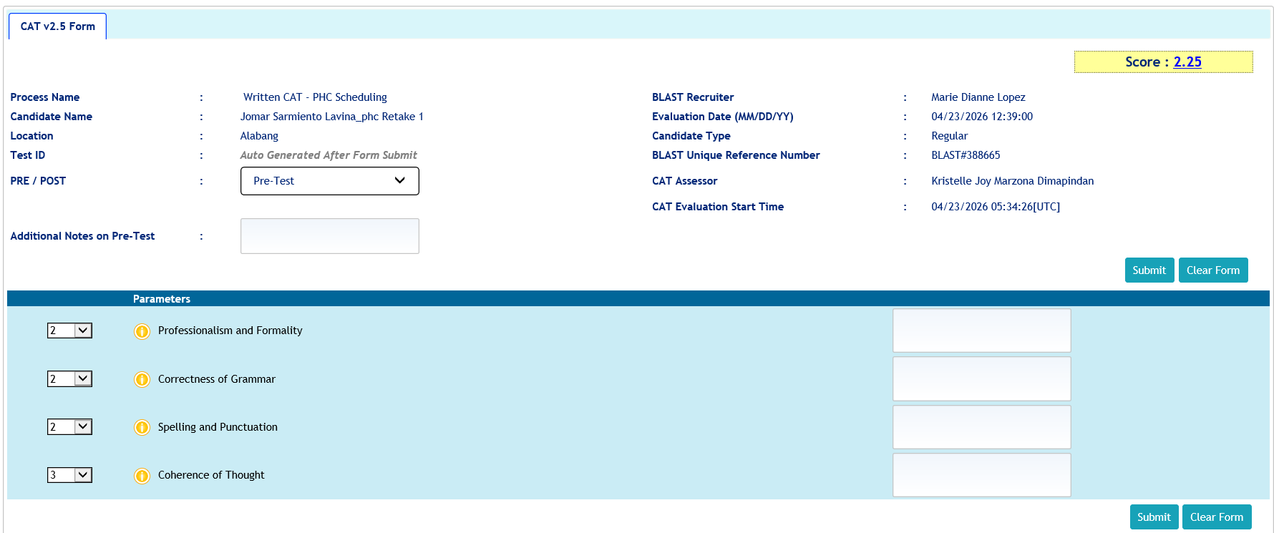
Non-voice CAT Endorsement Process (Email)
Recruiter creates candidate profile to generate BLAST ID via Lighthouse
Candidates with valid BLAST IDs will be endorsed to the CAT Center via Testmoz. CAT assessor will receive an email via Outlook once response was submitted.
Results are published real time
Assessment form is accessed via Lighthouse

Slide 6
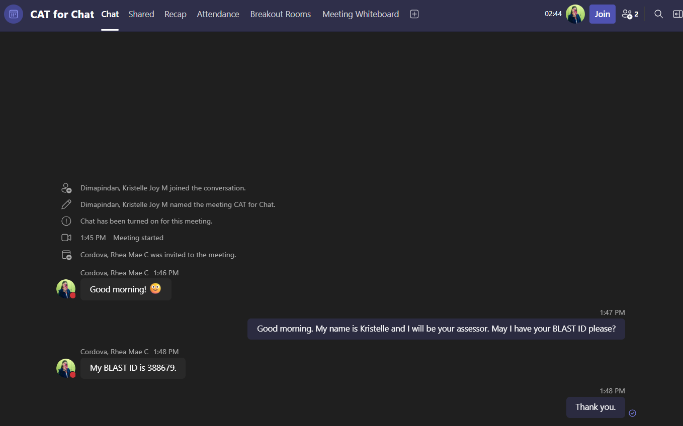
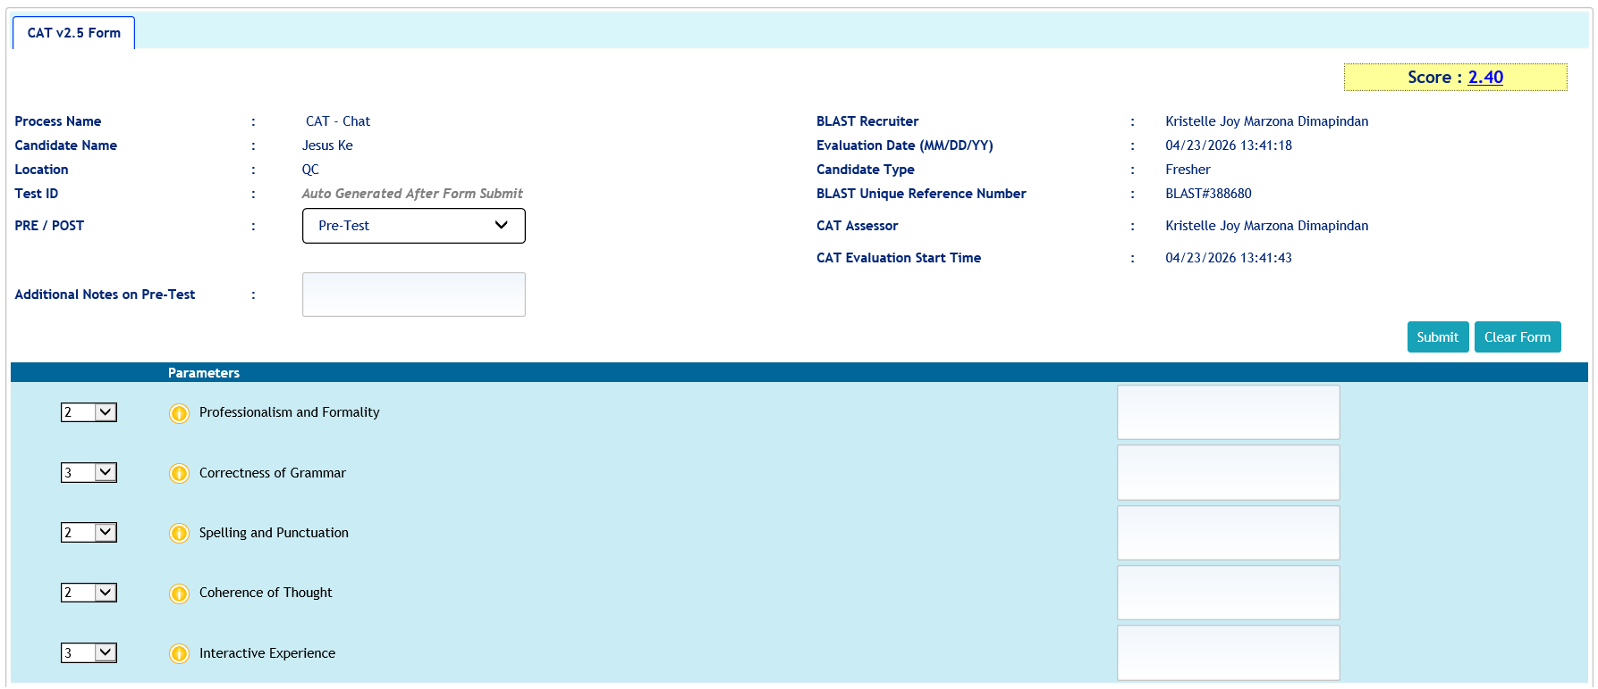
Non-voice CAT Endorsement Process (Chat)
Recruiter creates candidate profile to generate BLAST ID via Lighthouse
Candidates with valid BLAST IDs will be endorsed to the CAT Center via MS Teams. CAT assessors will share a meeting link with TA and will wait for candidate to join
Results are published real time
Assessment form is accessed via Lighthouse

Slide 7





Member Information
Dependent’s Information
Additional Resources
Member Name:
No.
Name
Date of Birth
Relation
Contact No.
Date of Birth:
1
Request for Letter of Authorization
Phone Number:
(814) 733-5456
2
Home Address:
1775 John McClane Avenue
Manifold, CA 92405
Collect the following information from the requesting party:
*Newly enrolled dependent information will reflect within 24 to 48 hours. Dependent’s HMO card will be delivered within 5 business days.
Emergency Contact:
[Update Needed]
E-mail Address:
[Update Needed]
Member’s Name
Policy Number
E-mail Address
Name of the Facility
Member’s Contact #
Plan Information
Billing Information
Policy Number:
265-747-7
Payment Information
Month
Premium Amount
Status
Top-up Premium
Status
Outstanding Balance
Silver Premium
Credit Card No.
**** **** **** 1457
Plan Type:
Paid
Insurance Provider:
United Healthcare
August
$280.00
-
-
-
*Email and SMS notification will be sent to facility and member, four (4) hours after submission of request.
Active
Membership Status:
Automatic Payment: YES
September
$280.00
Paid
$150.00 (Dental & Vision)
Unpaid
$150.00
05/01/2015
Effective Date:
October
$280.00
Unpaid
$150.00 (Dental & Vision)
Unpaid
$430.00
Accredited Facilities and Clinics
*This member enrolled to Dental and Vision Standalone Benefits on September 1, 202X. An additional $150.00 will be added on top of member’s monthly premium.
MANIFOLD GENERAL HOSPITAL
MIGHTY TEETH DENTAL CARE
How to File a Claim?
Drug & Medication
Submit your claims online at www.uhc.com or fax the following documents to 1-866-308-6294, attention to “Claims Department”:
Claim form with the member’s signature
Supporting medical documentation
Case ID on the cover sheet
Tax ID: 620728634
Tax ID: 235093485
Drug Name
Drug Type
Quantity & Limit
Total Price
Doctors
Dr. Adam L. Nail
Dr. Deena C. Pilgrim
Losartan
Hypertension
30 tabs • 2 tabs per day for 15 days
$12.00
Metformin
Diabetes
60 tabs • 2 tabs per day for 30 days
$10.00
Address
742 Highland Ave.
Manifold, California 92405
4588 Midland Way
Manifold, California 92415
Submit medication order for:
Home Delivery
Store Pick Up
Partner Pharmacies
(909) 881-732
Walgreens
Rite Aid Corporation
Safeway
Costco Pharmacies
Contact No.
(909) 789-558
*For home delivery, please expect medication to be delivered in 24 to 48 hours.
Clinic Hours
8am to 7pm
7am to 7pm

Slide 8



Scenario Mapping Voice CAT
Scenario
Synopsis
Expected Behavior or Skill
Scenario 1: Benefits and Eligibility + Account Update
The member called to check the list of pharmacies covered by her plan. They usually receive their medications through home delivery. However, her husband recently passed, and she would like to explore the store pick up option since she’ll be moving in with her son temporarily.
Empathy
Active Listening and Comprehension
Proper Setting of Expectations, Providing Options
Scenario 2: Bill Inquiry + Dependent Enrollment
The member is calling to complain about a bill she received for $580. She's upset because she just lost her job and still figuring out how to pay all her bills.
Empathy
Active Listening and Comprehension
Clear and Logical Explanation
Scenario 3: Filing a Claim + Benefits and Eligibility
The member called in to complain about the incorrect dosage of her medications. She skipped dinner to pick it up from the pharmacy and she feels it’s extremely inconvenient to have it replaced. She would like to know the process to file a claim.
Empathy
Active Listening and Comprehension
Positive Scripting, Proper Setting of Expectations, Providing Options
Scenario 4: Benefits and Eligibility + Letter of Authorization
Provider called in to confirm if their facility is an accredited UHC partner. He is set to undergo a procedure and was previously advised that it will not be covered. The provider was very upset because their back and forth with the member and UHC was time consuming.
Empathy
Active Listening and Comprehension
Positive Scripting, Proper Setting of Expectations
Scenario 5: Benefits and Eligibility + Deescalation
The member sounded upset because she was charged $20 instead of the usual $10 for her medication. She forgot to order her diabetes medication because she and her family just recently moved to their new home.
Empathy
Active Listening and Comprehension
Clear and Logical Explanation

Slide 9

Skills Mapping (Voice CAT)
Task
Skill
CAT Measure
US Patient Interaction
English Proficiency
Phonological Control, Lexical Resource, Grammar
Cultural Sensitivity
Use and Understanding of Idioms, Empathy, Rapport Building, Engaging in a Conversation
Lexical Resource, Interaction and Discourse Management
Account Management
Active Listening and Comprehension
Interaction and Discourse Management
Problem Solving
Probing, Critical Thinking and Decision Making
Interaction and Discourse Management
Customer Service
Positive Scripting, Proper Setting of Expectations, Providing Options
Interaction and Discourse Management, Coherence
Account Education
Clear and Logical Explanation, Providing Instructions
Coherence

Slide 10
Skills Mapping (Non-voice CAT)
Task
Skill
CAT Measure
Complete and Accurate Documentation
English Proficiency
Correctness of Grammar
Information Accuracy
Professionalism and Formality, Spelling and Punctuation, Coherence of Thought
Completeness of Documentation
Spelling and Punctuation, Coherence of Thought
Attention to Detail
Professionalism and Formality, Coherence of Thought

Slide 11
CAT Automation Pre-screening Test
Web-based Testing Application

Slide 12





CATalyze AI
Intelligent communication assessment and pre-screening solution
Problem Statement | Goal | Impact to Business
Limited assessment capacity due to manual live-call evaluations with an average assessment handling time of 15 minutes per candidate | Increase hiring efficiency and turnaround time by utilizing the pre-screening tool to filter candidates for live assessment Reduce live assessment time by 40% | Hiring efficiency
Heavy dependency on assessor availability and scheduling | Improve assessor utilization through AI-assisted pre-screening | Hiring scalability
Hiring surges create operational strain on the CAT team and inconsistent assessment pacing during peak recruitment periods | Reduce dependency on live assessor availability during high peaks and expand their coverage to support multiple business simultaneously Enable continuous and scalable assessment operations without the need to increase headcount
CATalyze AI is an AI-enabled communication assessment and pre-screening solution designed to automate the initial evaluation of candidate communication proficiency before live assessor engagement. The proposed solution will leverage speech analytics, AI-driven scoring, and scenario-based assessments aligned to CEFR communication standards to streamline hiring readiness evaluation.
The platform is designed to reduce dependency on live assessors for early-stage screening while improving assessment scalability, consistency and turnaround time.
Hiring Journey (future-state)
Profile Creation
Talent Acquisition will create profile and encode in Light House
AI-assisted pre-screening test
Candidates complete an automated and timed communication assessment tool.
Score/Report
Candidates who cleared the automated test will be endorsed to the CAT Center for mock call
Job Audition Live Assessment
Call simulation with CAT assessor
Score/Report
Candidates who cleared the job audition will be endorsed to hiring manager
Domain Interview
Candidate
New
Existing
Initial screening layer that validates basic English communicative skills before candidates proceed to live mock call assessments
Customizable business-specific live mock call assessment
Process Flow
Competencies to be assessed
Pronunciation and fluency checks
Listening and response exercises
Reading comprehension
Situational response recordings
Problem solving and critical thinking
Empathy and rapport building
Positive scripting/breaking bad news
Handling difficult customers
Assessment duration
10 minutes
5 minutes

Slide 13
CAT Automation
What problem are we trying to solve?
Limited number of calls per shift (20 calls/assessor/day)
15 minutes average handling time per assessment
High dependency on assessor availability
Hiring surges strain the CAT team
Fixed operating hours
Assessors have limited time for development and other projects
What is the solution?
Increase the number of assessments handled per shift
Reduce phone assessment time by 40-50%
Reduce dependency on assessor availability especially during hiring peaks
Continuous assessment without proportionally increasing headcount
Flexible operating hours
Enable assessors to focus on other projects like design and class facilitation
What are the challenges?
Software or Application to be used
Accessibility for virtual candidates

Slide 14




Hiring Journey
Job Audition Assessment
Call simulation with CAT assessor
Domain Interview
Candidate
Automated Pre-screening Test
Profile Creation
TA will create profile and encode
Score/Report
Candidates who cleared the automated test will be endorsed to the CAT Center for mock call
Score/Report
Candidates who cleared the job audition will be endorsed to hiring manager
Stock photo used.

Slide 15
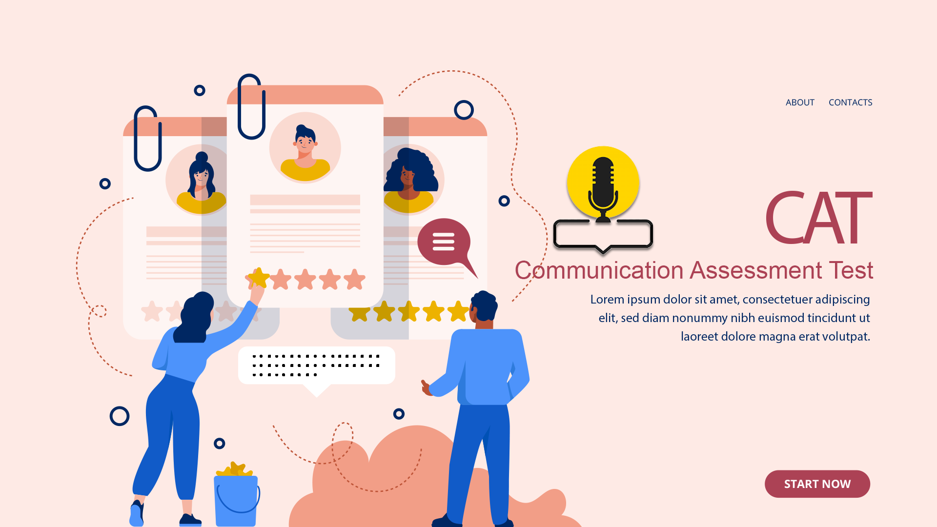

Slide 16


Pronunciation
READ WHAT YOU SEE
Pharmaceutical

Slide 17
Pronunciation
READ WHAT YOU SEE
I arrive at the office at 8:30 AM. I say good morning to all my workmates then I get a big cup of hot coffee. I turn on my computer and read my email. Some days I have a lot to read. Soon I need another cup of coffee.

Slide 18
Vocabulary
CHOOSE AND READ THE CORRECT SENTENCE
a. This book makes me inspire to do better.
b. This book gives me the inspiration to do better.
c. The book allows me inspiring to do better.

Slide 19
Vocabulary
CHOOSE THE CORRECT IDIOM TO COMPLETE THE SENTENCE
"I really want to help you but my ___. You should ask Colin for assistance."
a. hands are tied
b. fingers are crossed
c. nose is looking down

Slide 20
Grammar
COMPLETE THE SENTENCE
Jean’s birthday is _____ November.
a. in
b. on
c. at

Slide 21


Active Listening and Comprehension
LISTEN AND REPEAT

Slide 22

Conversation
RESPOND TO THE CALLER

Slide 23
Coherence
COMPLETE THE INSTRUCTIONS BY USING THE CORRECT SEQUENCE MARKERS
___, cut a dozen lemons in half and squeeze all the juice out of them. ___, pour the juice into a container with a half cup of sugar. Add a very small amount of water into your container, ___ stir until the sugar dissolves. ___ stirring, add more water and ice. ___, pour into glasses and serve.
then, finally, next, first, after

Slide 24




AURA (AI Unified Recruitment Assistant)
AI-based talent intelligence platform
AURA is an AI-powered hiring assessment platform that evaluates communication skills utilizing CEFR, workplace readiness, learning agility, and role-specific competencies. Through AI-driven assessments and advanced analytics, it identifies talent potential and enhances hiring outcomes across the entire employee lifecycle—from pre-hire screening and selection to onboarding, role certification, internal mobility, leadership readiness, and ongoing workforce development. By delivering objective, data-driven, and actionable insights, AURA empowers to make informed talent decisions and build a high-performing workforce.
Phase 1: Voice language and communication assessment
Phase 2: Written language and communication assessment
Phase 3: Role-based assessment
Phase 4: Adaptive AI interview and aptitude test
Assess an individual’s ability to understand and use English in everyday and workplace situations. It evaluates how effectively a person can communicate in spoken English at a natural, fluent pace.
Online assessment that measures an individual’s ability to communicate effectively in written everyday and workplace situation in English.
Predicts job success by assessing critical hard and soft skills required for specific roles. Candidates complete a brief, engaging job-relevant assessment which provides a comprehensive view of their role readiness, cultural and team fit, and long-term potential.
A multimodal AI assessment that evaluates cognitive ability, workplace readiness and learning agility while generating hiring recommendations, development plans, and workforce analytics. It’s a one-stop shop, built around several assessment domain, all measured from one interview.
How it Works
The test is composed of various assessment sections designed to evaluate different aspects of language proficiency, such as Read and Speak, Listen and Repeat, and Listening Comprehension.
Results include an overall score as well as detailed scores for Speaking, Listening, and Reading.
The test comprises several assessment components, such as Sentence Completion, Listen and Write, Writing, and Email Writing, designed to evaluate a range of workplace communication skills.
Candidates receive an overall score as well as detailed scores for each section.
Assesses functional, technical, soft skills, and behavioral competencies aligned with the CMF requirements of a specific role.
Candidates participates in targeted assessment activities tailored to the role being evaluated, providing a comprehensive view of their capabilities and job fit.
Includes a variety of assessment activities designed to support both external hiring and internal talent mobility, such as domain interviews, business conversations, role simulations, and more, all facilitated by an AI-powered avatar.
The assessment generates competency-based scores and recommendations aligned with the requirements of the role being evaluated.
Skills and Competencies
Phonological Control
Lexical Resource
Spelling & Punctuation
Professionalism & Formality
Functional Skills
Technical Skills
Problem Solving
Judgement
Communication
Grammatical Accuracy
Coherence
IDM
Soft Skills
Behavioral
Professionalism
Decision Making
Rapport Building
Coherence of Thought
Grammar

Slide 25
Assessment Overview
Assessment | Purpose | Activities | Skills/Competencies Assessed | Duration (m) | Best Used For | Development Phase
Communication Proficiency Assessment | Measures the ability to understand and communicate spoken English at a native like pace | Read and Speak (Reading & Speaking) Listen and Repeat (Speaking) Sentence Construction (Speaking) Listening Comprehension (Listening) Sentence Completion (Reading) Reading Comprehension (Reading) Conversations (Listening) Read and Reconstruct (Writing) Opinion (Writing) | Phonological control Lexical resource Grammatical accuracy IDM: Comprehension | 60 | External placement Determining learner proficiency | Phase 1
Professional Communication Assessment | Measures workplace English proficiency and business communication readiness | Sentence Completion (Reading & Writing) Read and Reconstruct (Writing) Reading Comprehension (Reading) Email Writing (Writing) Listen and Write (Listening & Writing) Listening Comprehension (Listening) Listen and Repeat (Speaking) Sentence Construction (Speaking) Storytelling (Speaking) Opinion (Writing) | Phonological control Lexical resource Grammatical accuracy IDM Coherence | 60 | Internal talent mobility Workforce cross skilling Workforce upskilling and development | Phase 1
Written Communication Assessment | Measures the ability to communicate in commonly used written workplace English | Sentence Completion Listen and Write Read and Reconstruct Interpret and Write Email Writing | Spelling and punctuation Professionalism and formality Coherence of thought Grammar | 60 | External placement, Determining learner proficiency Workforce cross skilling Workforce upskilling and development | Phase 2

Slide 26
Assessment Overview
Assessment | Purpose | Activities | Skills/Competencies Assessed | Duration (m) | Best Used For | Development Phase
Role-Based Assessment | A competency-driven role assessment that predicts job success by evaluating candidates through realistic work simulations, technical challenges, behavioral interviews, situational judgement tests, and AI-assisted role-pays customized for every position. | Knowledge validation Technical demonstration Job simulation Situational scenarios Role-plays | Role-dependent; to be aligned to each role’s CMF functional, technical and soft skills | 60 | External placement Internal promotion Talent mobility | Phase 3
Adaptive AI Interview and Aptitude Test | Measures a candidate’s cognitive ability, workplace agility, learning agility, cultural fit, leadership readiness, and other role-specific competencies. The assessment provides a comprehensive evaluation of the skills and behaviors required for success in the role, offering hiring managers deeper insights into a candidate’s suitability, potential, and overall job fit. | Domain interview Role simulations Scenario-based questions Cognitive problem-solving Summarizing an information Explain complex idea in simple term Storytelling activity Prioritization challenge Pattern recognition Behavioral and leadership scenarios Situational judgement Ethical dilemma Coaching conversation Performance feedback exercise Interview questions and activities to be aligned to a role (i.e., PM or IC, training manager, project manager) | Domain-specific competencies Critical thinking Decision-making Business judgement Time management Analytical thinking Problem-solving Logical thinking Ownership Integrity Self-awareness Adaptability Stress tolerance Resilience Collaboration Conflict resolution Professional maturity Empathy Accountability | 60 | Promotion readiness Leadership assessment Talent mobility | Phase 4

Slide 27


Voice CAT Parameters
Phonological Control
Lexical Resource
Grammatical Accuracy
Interaction and Discourse Management
Coherence
Pronunciation
Speech Clarity
Pace
Vocabulary
Sentence Structure
Use and Understanding of Idiomatic Expressions
Subject-Verb Agreement
Verb Tenses
Prepositions
Articles
Conversational Skills
Empathy and Rapport
Probing
Critical Thinking and Decision Making
Problem Solving
Positive Scripting
Tone
Comprehension
Logical Presentation of Ideas
Clear and Easy to Follow Instructions
Directness of Responses

Slide 28
Non-voice CAT Parameters
Professionalism and Formality
Correctness of Grammar
Spelling and Punctuation
Coherence of Thought
Timeliness
Capitalization
Appropriate use of acronyms and abbreviations
Use of Jargon
Sentence Structure
Subject-Verb Agreement
Verb Tenses
Prepositions
Articles
Correctness in spelling
Proper Punctuation
Complete and concise correspondence
Correctness and Accuracy of information
Comprehension

Slide 29


Phase 1: Voice language and communication assessment
Part 1
Part 2
Part 3
Part 4
Short text description. Arial 14pt, regular. Short text description. Arial 14pt, regular.
Short text description. Arial 14pt, regular. Short text description. Arial 14pt, regular.
Short text description. Arial 14pt, regular. Short text description. Arial 14pt, regular.
Short text description. Arial 14pt, regular. Short text description. Arial 14pt, regular.
Outcomes
Short text description. Arial 14pt, regular. Short text description. Arial 14pt, regular.
Short text description. Arial 14pt, regular. Short text description. Arial 14pt, regular.
Short text description. Arial 14pt, regular. Short text description. Arial 14pt, regular.
Short text description. Arial 14pt, regular. Short text description. Arial 14pt, regular.

Slide 30




Four items
Experienced and accredited
Solutions for every challenge
Innovative technology
Proven value
A pioneer of innovations around virtually every type of population

Slide 31




Four items
Listening
Empowering
Innovating
Reinforcing
What are we hearing from our customers – including clients, members, patients and consumers?
What unique customer needs do we struggle to address today?
What prevents us from consistently making things better for our customers?
How can we change the way we think about our experience or offering to make it simpler and more personal?
What new offerings or experiences would remove barriers or create a higher level of service?
Where have you seen the successful delivery of our promise in action?
How do we do more of that?

